Slide 1
Classification

Slide 2



Applications of Classification
Recognizing spam emails
Spam
filtering
Function
Yes/No
Yes
Training
Data
No
(http://spam-filter-review.toptenreviews.com/)

Slide 3



Applications of Classification
Document Classification
政治
Function
财经
教育
Training Data
教育
政治
财经
http://top-breaking-news.com/

Slide 4
Probability Basics

Slide 5
Basic Concepts of Probability
Random experiment: an experiment with uncertain outcome (e.g., tossing a coin)
Sample space: all possible outcomes, e.g.,
Tossing 2 fair coins, S ={HH, HT, TH, TT}
Event: E⊆S, E happens iff outcome is in E, e.g.,
E={HH} (all heads)
E={HH,TT} (same face)
Impossible event ({}), certain event (S)
Probability of Event: 1≥P(E) ≥0, s.t.
P(S)=1 (outcome always in S)
P(A∪B)=P(A)+P(B) if (A∩B)=∅ (e.g., A=same face, B=different face)

Slide 6
Basic Concepts of Probability
Conditional Probability: P(B|A)=P(A∩B)/P(A)
P(A∩B) = P(A)P(B|A) =P(B)P(A|B)
So, P(A|B)=P(B|A)P(A)/P(B) (Bayes’ Rule)
For independent events, P(A∩B) = P(A)P(B), so P(A|B)=P(A)
Total probability: If A₁, …,A_{n} form a partition of S, then
P(B) = P(B∩S) = P(B∩A₁) + … + P(B ∩A_{n}) (why?)
So, P(A_{i}|B) = P(B|A_{i})P(A_{i})/P(B)
= P(B|A_{i})P(A_{i})/[P(B|A₁)P(A₁)+…+P(B|A_{n})P(A_{n})]
This allows us to compute P(A_{i}|B) based on P(B|A_{i})

Slide 7
Random Variable
X: S → ℜ (“measure” of outcome)
E.g., number of heads, …
Events can be defined according to X
E(X=a) = {s_{i}|X(s_{i}) = a}
E(X≥a) = {s_{i}|X(s_{i}) ≥ a}
So, probabilities can be defined on X
P(X=a) = P(E(X=a))
P(X≥a) = P(E(X≥a))
Discrete vs. continuous random variable

Slide 8
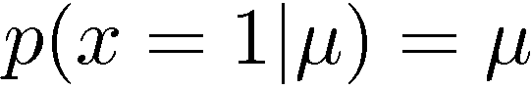
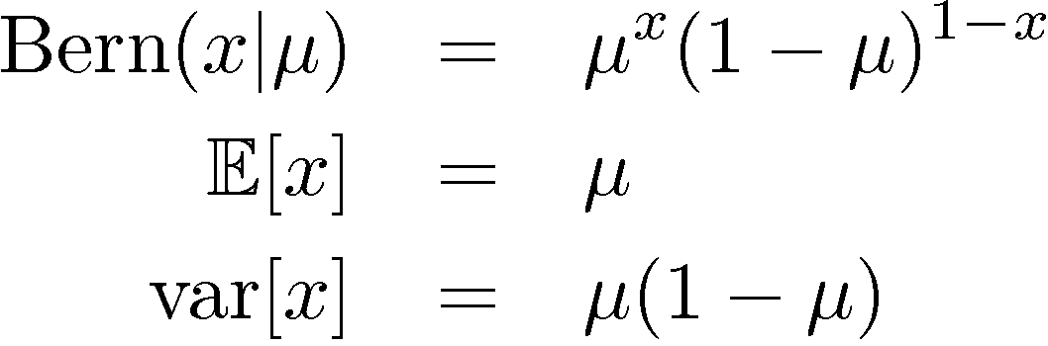
Bernoulli Distribution
Coin flipping: heads=1, tails=0
Bernoulli Distribution

Slide 9
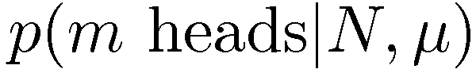
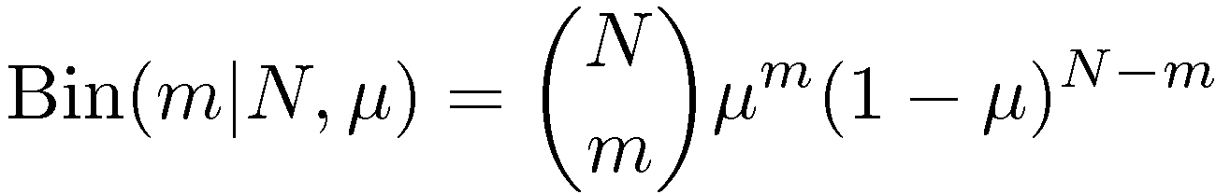
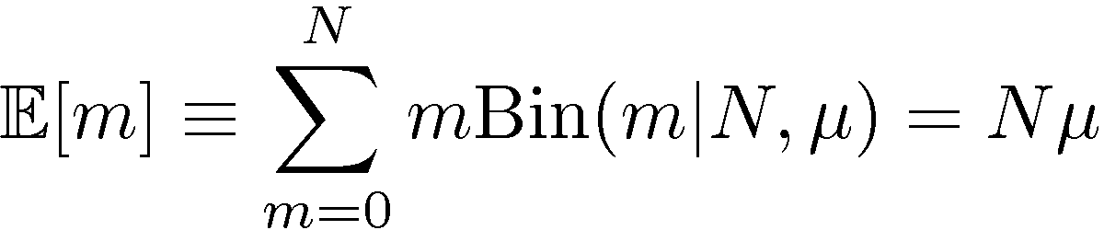
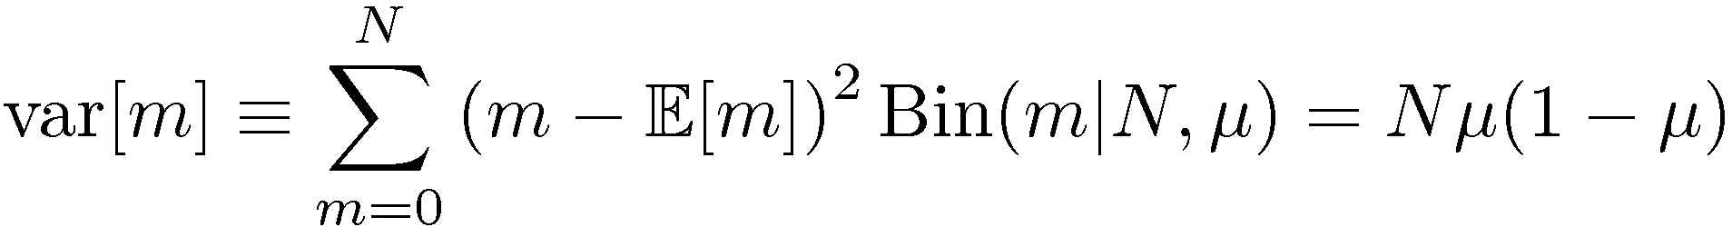
Binomial Distribution
N coin flips:
Binomial Distribution

Slide 10
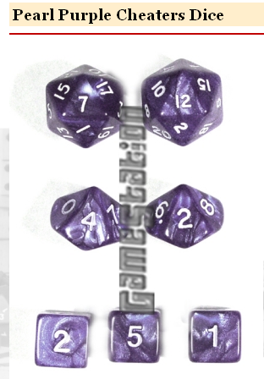
A practical problem
I bought a loaded twenty-sided dice on Taobao…but it didn’t come with any specs. How can I find out how it behaves?
1. Collect some data (20 rolls)
2. Estimate P(i)=C(rolls of i)/C(any roll)
Notes:
specs英 [speks] 美 [spɛks] n.规范;眼镜;投机，说明，规格( spec的名词复数 )

Slide 11
One solution
I bought a loaded twenty-sided dice on Taobao…but it didn’t come with any specs. How can I find out how it behaves?
P(1)=0
P(2)=0
P(3)=0
P(4)=0.1
…
P(19)=0.25
P(20)=0.2
MLE = maximum
likelihood estimate
But: Do you really think it’s impossible to roll a 1,2 or 3?

Slide 12
A better solution
I bought a loaded twenty-sided dice on Taobao…but it didn’t come with any specs. How can I find out how it behaves?
0. Imagine some data (20 rolls, each i shows up once)
1. Collect some data (20 rolls)
2. Estimate P(i)=C(rolls of i)/C(any roll)

Slide 13
A better solution
I bought a loaded twenty-sided dice on Taobao…but it didn’t come with any specs. How can I find out how it behaves?
P(1)=1/40
P(2)=1/40
P(3)=1/40
P(4)=(2+1)/40
…
P(19)=(5+1)/40
P(20)=(4+1)/40=1/8
Really different! Maybe I should “imagine” less data?

Slide 14
A better solution
Q: What if I used m rolls with a probability of q=1/20 of rolling any i?
I can use this formula with m>20, or with m<20 … say with m=1

Slide 15
A better solution
Q: What if I used m rolls with a probability of q=1/20 of rolling any i?
If m>>C(ANY) then your imagination q rules
If m<<C(ANY) then your data rules BUT you never end up with P(i)=0

Slide 16
Terminology – more later
This is called a uniform Dirichlet prior
C(i), C(ANY) are sufficient statistics
MLE = maximum
likelihood estimate
MAP= maximum
a posteriori estimate

Slide 17
The Joint Distribution
Example: Boolean variables A, B, C
Recipe for making a joint distribution of M variables:
Notes:
recipe英 [ˈresəpi] 美 [ˈresəpi] n.食谱;处方;秘诀

Slide 18
The Joint Distribution
Example: Boolean variables A, B, C
Recipe for making a joint distribution of M variables:
Make a truth table listing all combinations of values of your variables (if there are M Boolean variables then the table will have 2^{M} rows).
A | B | C
0 | 0 | 0
0 | 0 | 1
0 | 1 | 0
0 | 1 | 1
1 | 0 | 0
1 | 0 | 1
1 | 1 | 0
1 | 1 | 1

Slide 19
The Joint Distribution
Example: Boolean variables A, B, C
Recipe for making a joint distribution of M variables:
Make a truth table listing all combinations of values of your variables (if there are M Boolean variables then the table will have 2^{M} rows).
For each combination of values, say how probable it is.
A | B | C | Prob
0 | 0 | 0 | 0.30
0 | 0 | 1 | 0.05
0 | 1 | 0 | 0.10
0 | 1 | 1 | 0.05
1 | 0 | 0 | 0.05
1 | 0 | 1 | 0.10
1 | 1 | 0 | 0.25
1 | 1 | 1 | 0.10

Slide 20
The Joint Distribution
Example: Boolean variables A, B, C
Recipe for making a joint distribution of M variables:
Make a truth table listing all combinations of values of your variables (if there are M Boolean variables then the table will have 2^{M} rows).
For each combination of values, say how probable it is.
If you subscribe to the axioms of probability, those numbers must sum to 1.
A | B | C | Prob
0 | 0 | 0 | 0.30
0 | 0 | 1 | 0.05
0 | 1 | 0 | 0.10
0 | 1 | 1 | 0.05
1 | 0 | 0 | 0.05
1 | 0 | 1 | 0.10
1 | 1 | 0 | 0.25
1 | 1 | 1 | 0.10
A
0.05
0.10
0.05
0.10
0.25
0.05
C
B
0.10
0.30

Slide 21
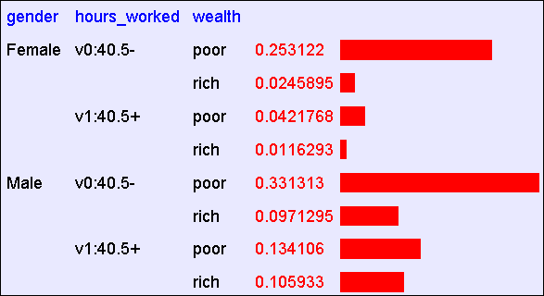
Using the Joint
One you have the joint distribution you can ask for the probability of any logical expression involving your attribute
Abstract: Predict whether income exceeds $50K/yr based on census data. Also known as "Census Income" dataset. [Kohavi, 1996]
Number of Instances: 48,842
Number of Attributes: 14 (in UCI’s copy of dataset); 3 (here)
Notes:
census英 [ˈsensəs] 美 [ˈsɛnsəs] n.人口普查，统计;人口财产调查

Slide 22
Using the Joint
One you have the joint distribution you can ask for the probability of any logical expression involving your attribute
Notes:
census英 [ˈsensəs] 美 [ˈsɛnsəs] n.人口普查，统计;人口财产调查

Slide 23
Using the Joint
P(Poor, Male) = 0.4654

Slide 24
Using the Joint
P(Poor) = 0.7604

Slide 25
Inference with the Joint

Slide 26
Inference with the Joint
P(Male | Poor) = 0.4654 / 0.7604 = 0.612
P(Poor, Male) = 0.4654
P(Poor) = 0.7604

Slide 27
Estimating the joint distribution
Collect some data points
Estimate the probability P(E1=e1 ^ … ^ En=en) as #(that row appears)/#(any row appears)
….
Gender | Hours | Wealth
g1 | h1 | w1
g2 | h2 | w2
.. | … | …
gN | hN | wN

Slide 28
Naïve Bayes
too simple, sometimes naive
Notes:
too simple, sometimes naive

Slide 29
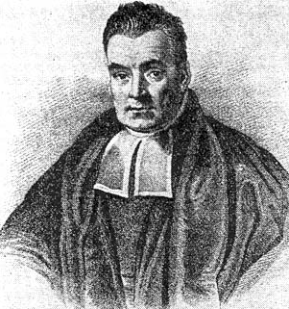
Bayes Rule
Bayes, Thomas (1763) An essay towards solving a problem in the doctrine of chances. Philosophical Transactions of the Royal Society of London, 53:370-418
Likelihood
Probability of D given h
Prior Probability of hypothesis h
Posterior Probability of h given D

Slide 30
A simple shopping cart example
Customer | Zipcode | bought organic | bought green tea
1 | 37922 | Yes | Yes
2 | 37923 | No | No
3 | 37923 | Yes | Yes
4 | 37916 | No | No
5 | 37993 | Yes | No
6 | 37922 | No | Yes
7 | 37922 | No | No
8 | 37923 | No | No
9 | 37916 | Yes | Yes
10 | 37993 | Yes | Yes
What is the probability that a person is in zipcode 37923?
3/10
What is the probability that the person is from 37923 knowing that he bought green tea?
1/5
Now, if we want to display an ad only if the person is likely to buy tea. We know that the person lives in 37922. Two competing hypothesis exist:
The person will buy green tea
P(buyGreenTea|37922) =
The person will not buy green tea
P(~buyGreenTea|37922) =
We will show the ad!
2/3
1/3

Slide 31
Maximum a Posteriori (MAP) hypothesis
Let D represent the data I know about a particular customer: E.g., Lives in zipcode 37922.
Suppose, I want to send a flyer (from three possible ones: laptop, desktop, tablet), what should I do?
Bayes Rule:
Notes:
flyer英 [ˈflaɪə(r)] 美 [ˈflaɪɚ] n.传单;飞鸟;飞行员;飞行物

Slide 32

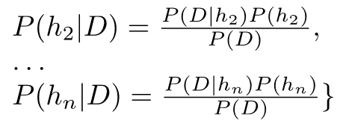
MAP hypothesis: (2) Formal Definition
Given a large number of hypotheses h₁, h₂, …, h_{n}, and data D, we can evaluate:

Slide 33
MAP : Example (1)
A patient takes a cancer lab test and it comes back positive. The test returns a correct positive result 98% of the cases, in which case the disease is actually present. It also returns a correct negative result 97% of the cases, in which case the disease is not present. Further, 0.008 of the entire population actually have the cancer.
Suppose Alice comes in for a test. Her result is positive. Does she have to worry about having cancer?

Slide 34

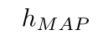
MAP: Example (2)
Suppose Alice comes in for a test. Her result is positive. Does she have to worry about having cancer?
Alice may not have cancer!!
Making our answers pretty: 0.0078/(0.0078 + 0.0298) = 0.21
Alice may have a chance of 21% in actually having cancer!!
Notes:
0.03764

Slide 35

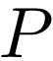
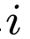
Naïve Bayes Classifier
Assume a target function with f: X→V, where each instance x is described by <x₁, x₂, …, x_{n}>. Most probable value of f(x) is:
Using the Naïve Bayes assumption:

Slide 36
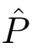
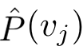
Notes of caution! (1)
Conditional independence is often violated
We don’t need the estimated posteriors to be correct, only need:
Usually, posteriors are close to 0 or 1

Slide 37
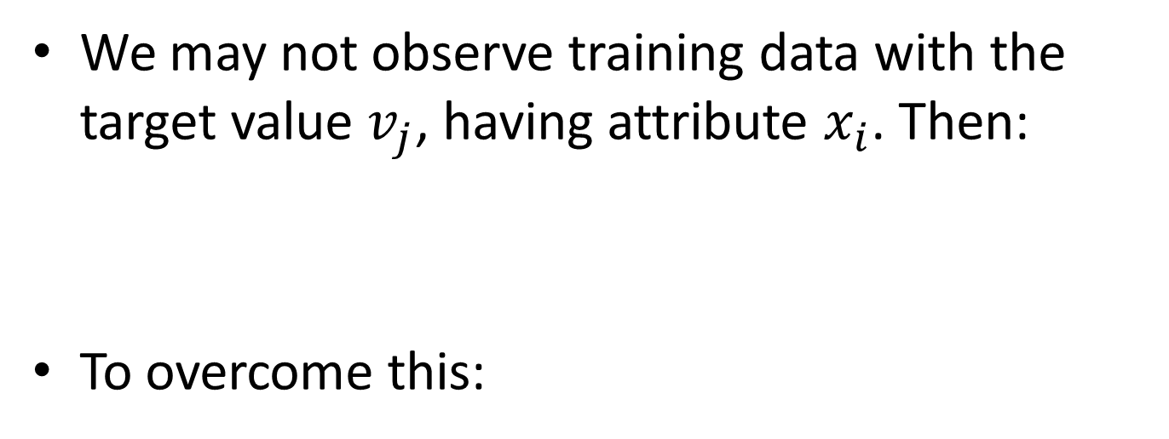
Notes of caution! (2)
We may not observe training data with the target value $v_{j}$, having attribute $x_{i}$. Then:
To overcome this:
nc is the number of examples where v = v_j and x = x_i
m is weight given to prior (e.g, no. of virtual examples)
p is the prior estimate
n is total number of training examples where v=v_j

Slide 38
Example of recognizing spam emails

Slide 39
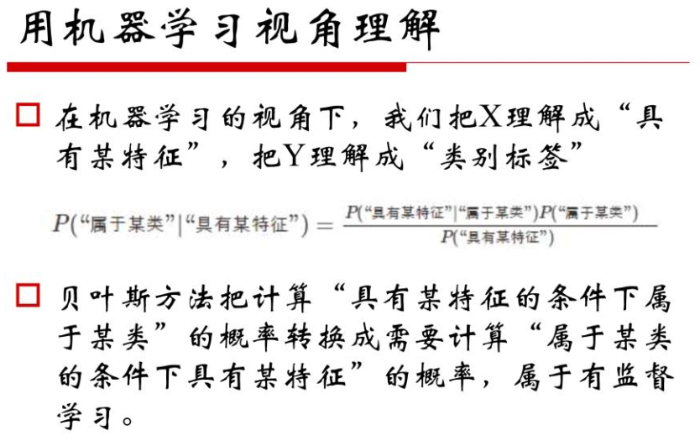

机器学习与深度学习
链接：https://pan.baidu.com/s/1VdMGvEgy7qYbR1fP6-uY8w 密码：g8j7

Slide 40
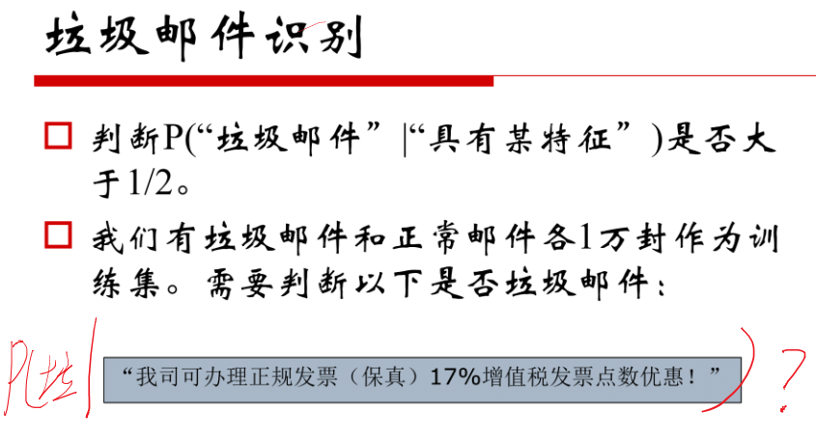

Slide 41
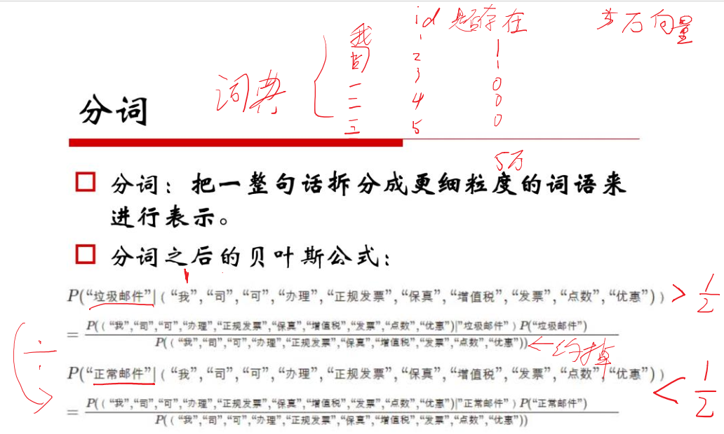

Slide 42
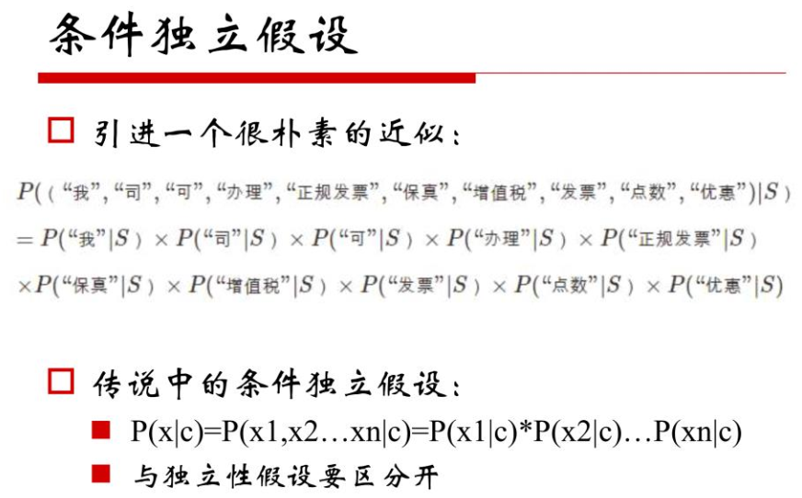

Slide 43
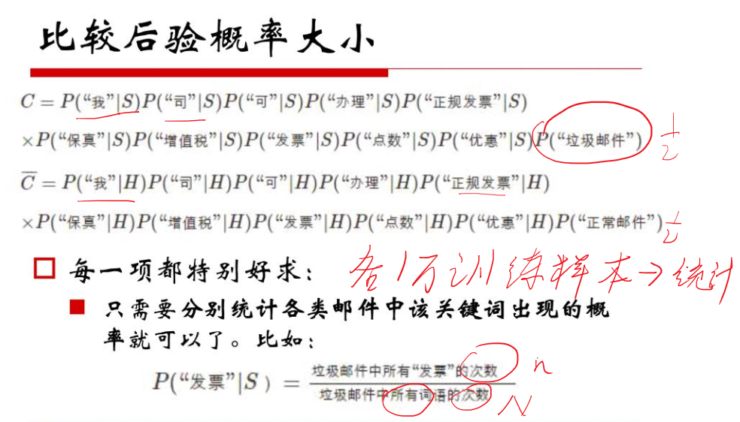

Slide 45
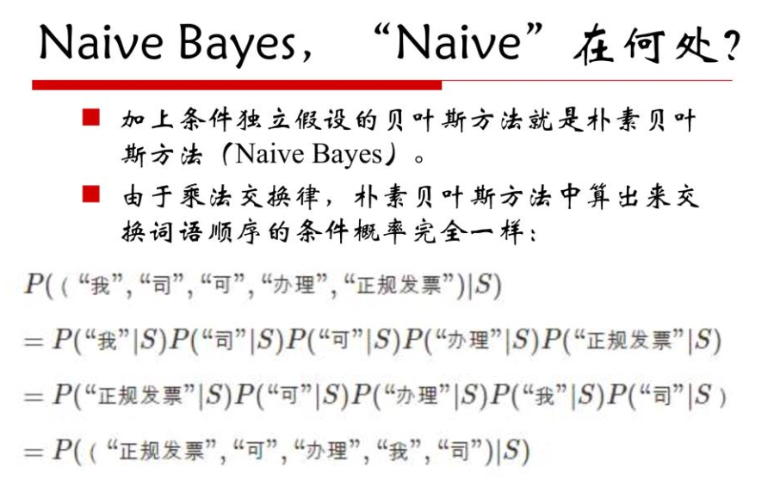

Slide 46
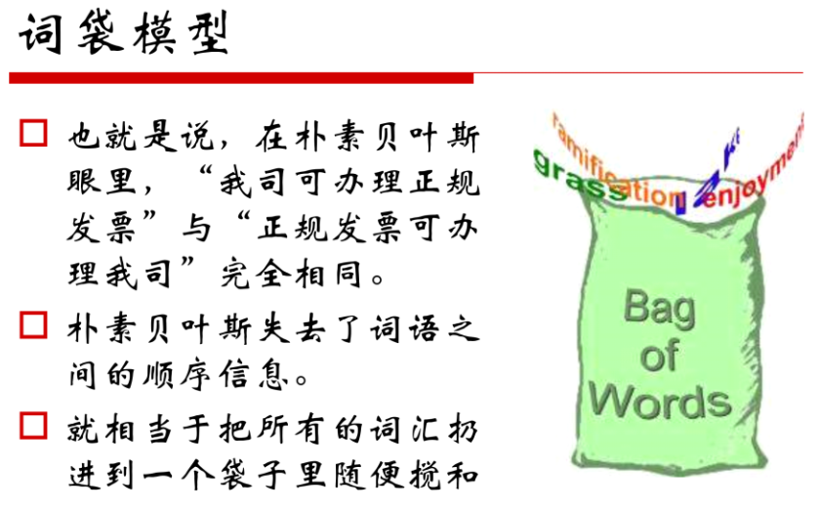

Slide 47
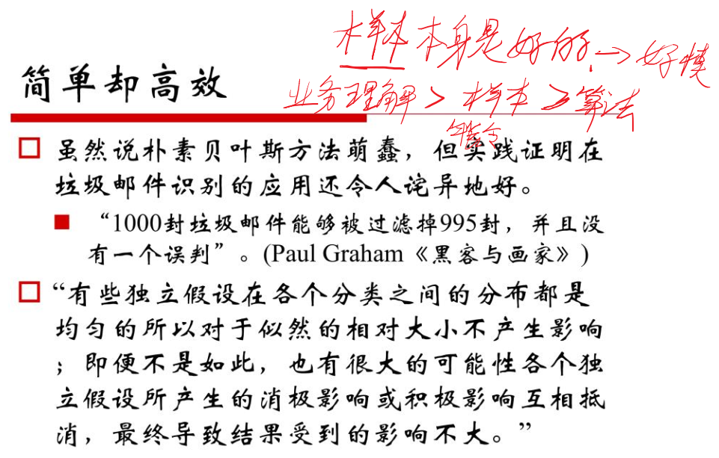

Slide 48
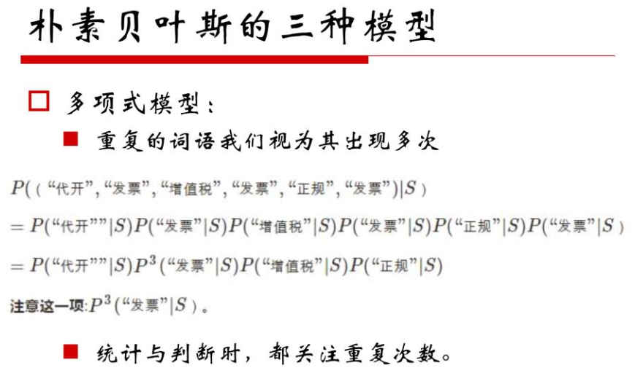

Slide 49
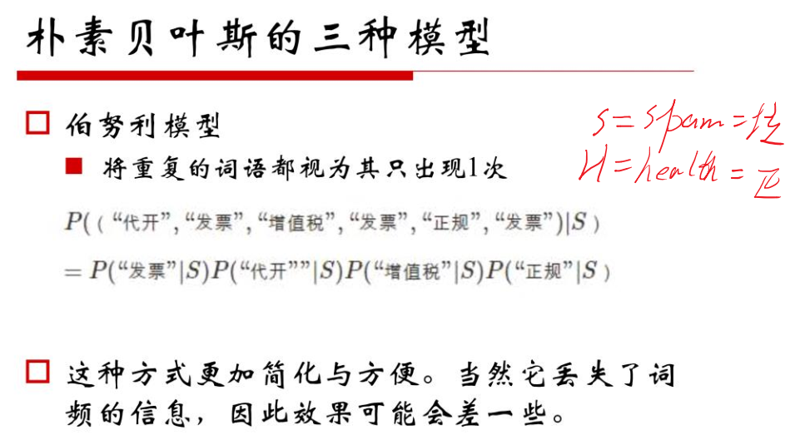

Slide 50
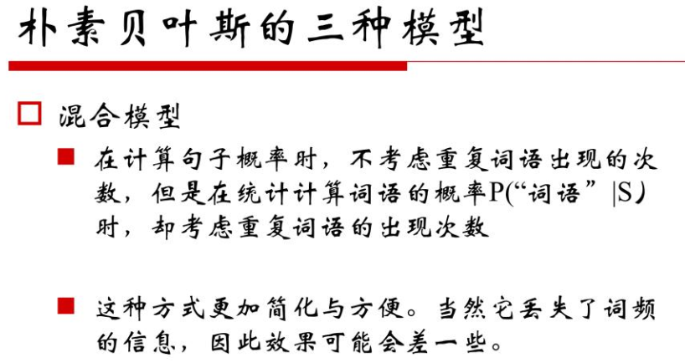

Slide 51
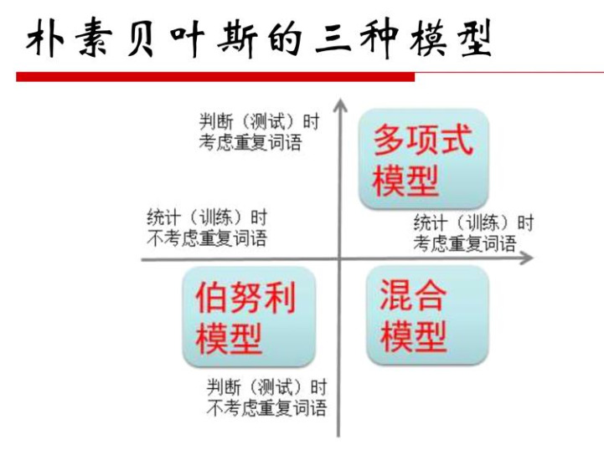

Slide 52
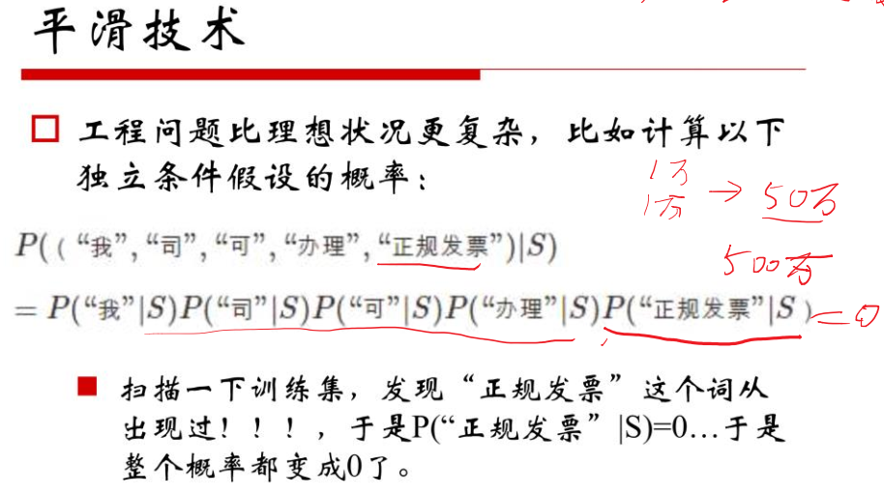

Slide 53
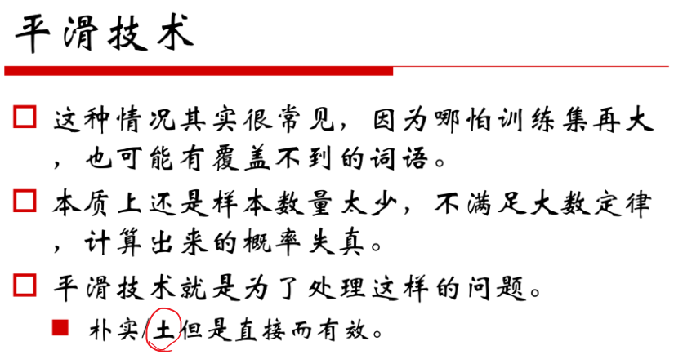

Slide 54
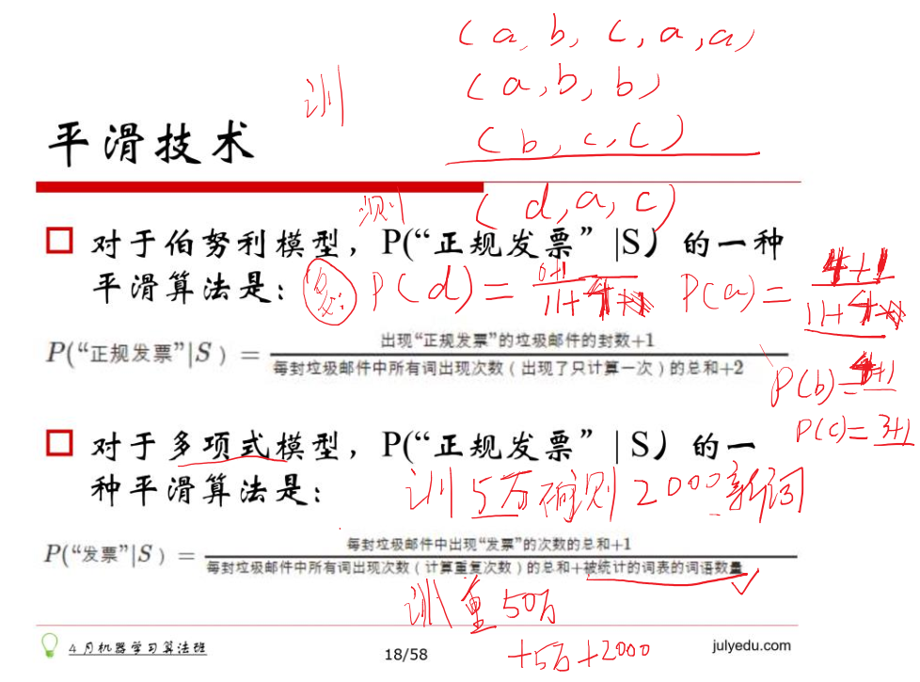

Slide 55
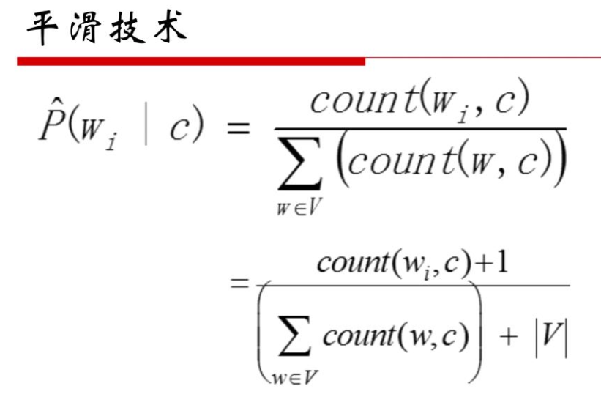

Slide 56
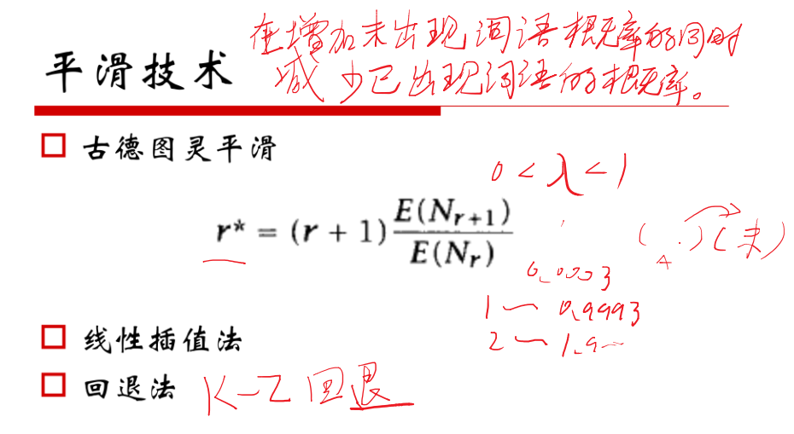

Slide 57
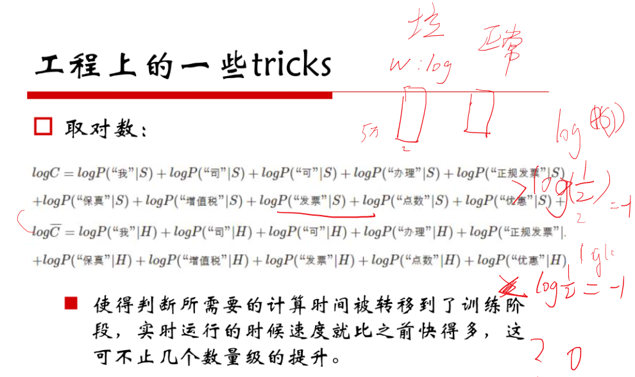

Slide 58
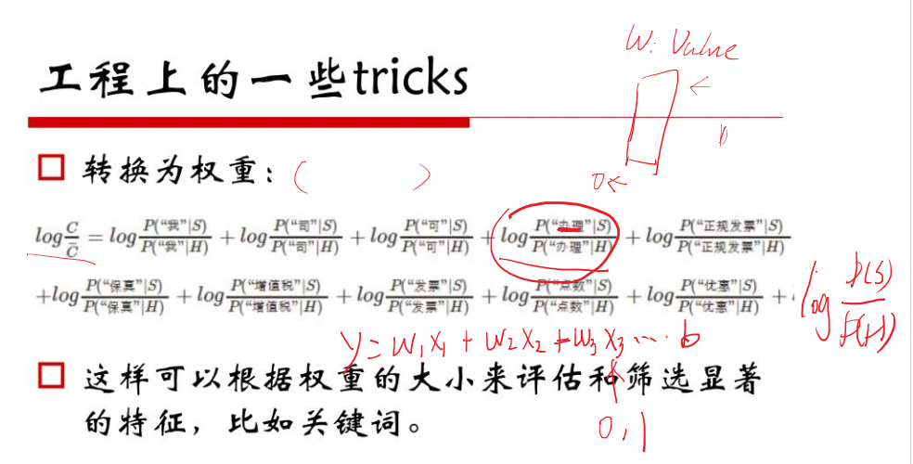

Slide 59
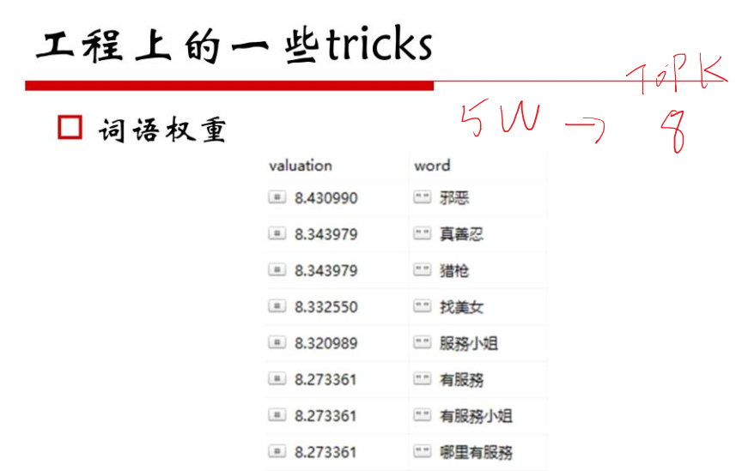
Notes:
valuation英 [ˌvæljuˈeɪʃn] 美 [ˌvæljuˈeʃən] n.估价;评价;定价;估定的价格或价值

Slide 60
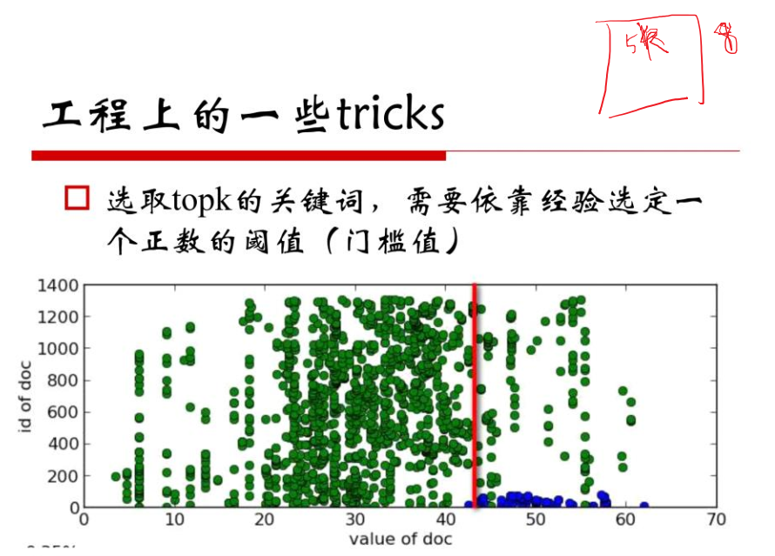

Slide 61
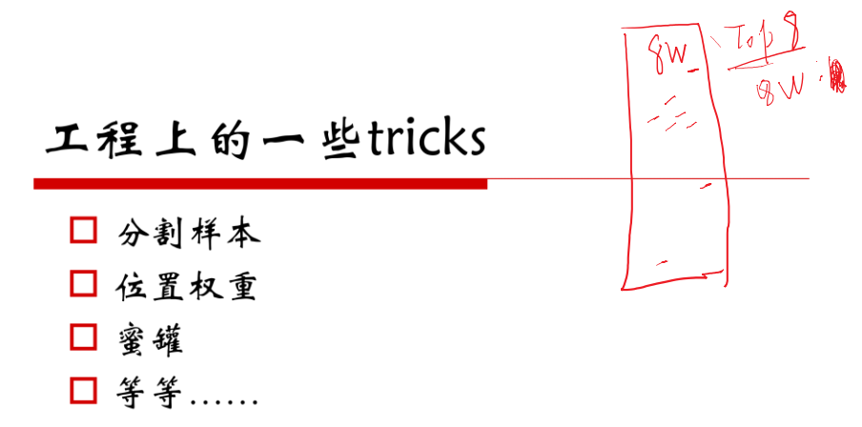

Slide 62
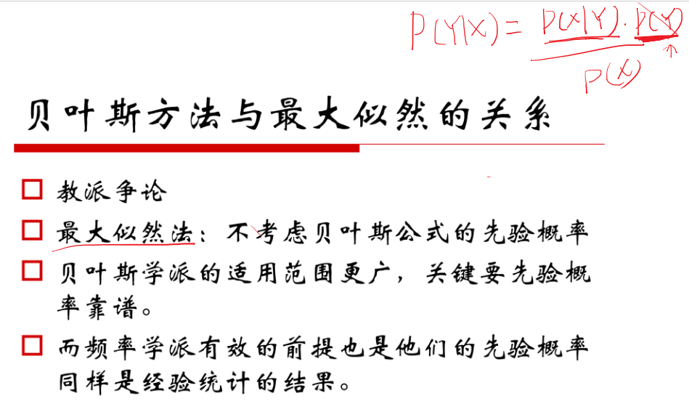

Slide 63
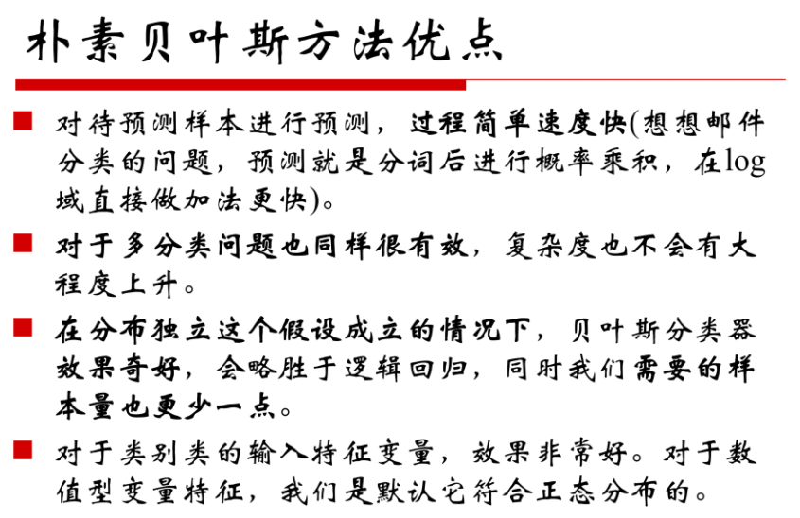

Slide 64
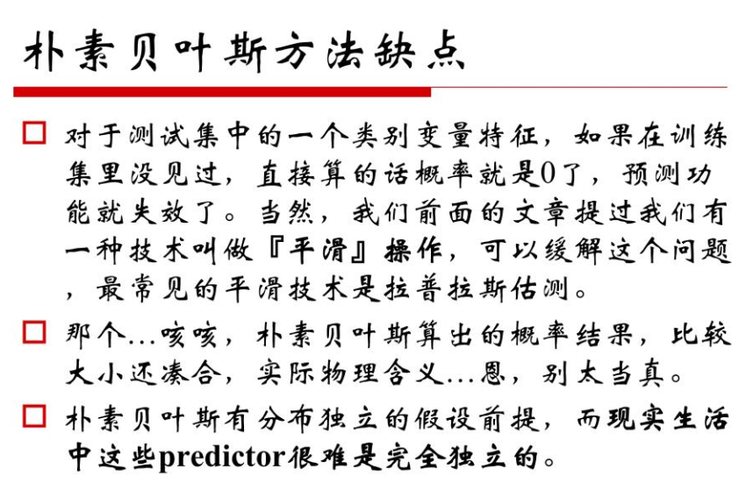

Slide 65
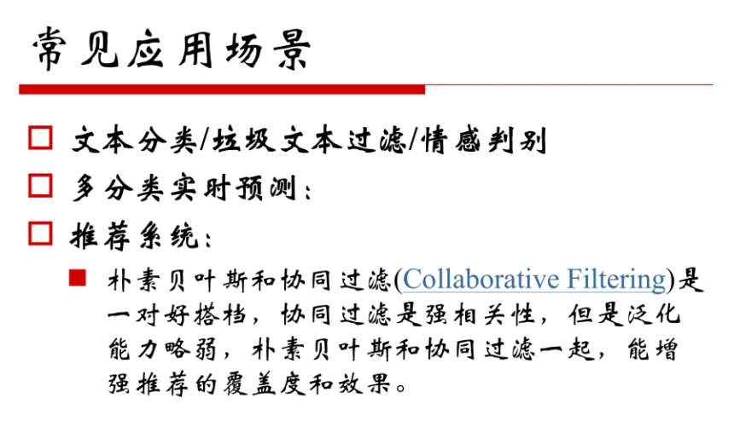

Slide 66
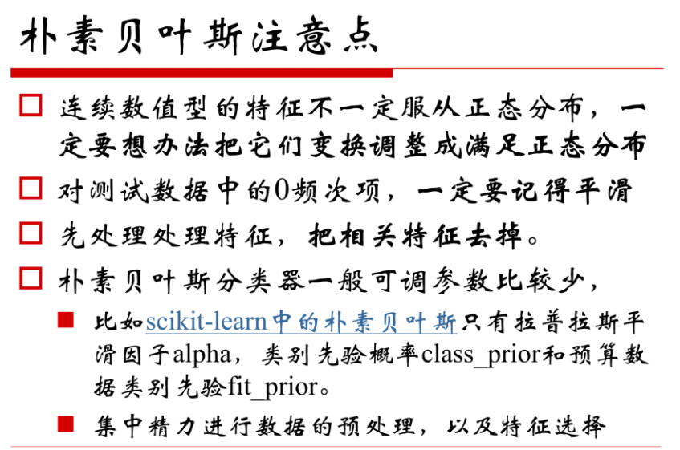

Slide 67
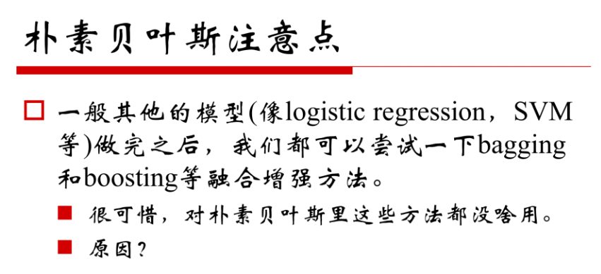

Slide 68
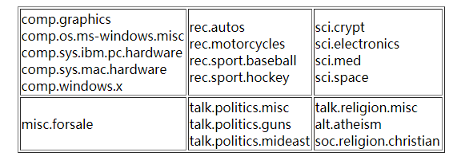
Homework 2: NBC
Deadline: 2018.10.17, 23:00
实现朴素贝叶斯分类器，测试其在20 Newsgroups数据集上的效果。
The 20 Newsgroups dataset is a collection of approximately 20,000 newsgroup documents, partitioned (nearly) evenly across 20 different newsgroups.
20news-18828.tar.gz - 20 Newsgroups; duplicates removed, only "From" and "Subject" headers (18828 documents)
http://qwone.com/~jason/20Newsgroups/

Slide 69
Today’s reading
Introduction to Information Retrieval
Chapter 13: Text classification and Naive Bayes
13.2 – Naive Bayes text classification
13.4 – Properties of Naive Bayes

Slide 70
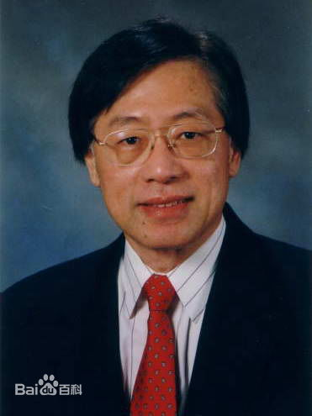
Enjoy Suffering
享受痛苦？
今年年初的澳网决赛，是史上历时最长的网球比赛。在这场比赛里，纳达尔历经近六个小时的比赛之后输了。他在比赛以后讲的话非常令人感动。他说：你能在赛场上不断挑战自己身体的极限，这可以说是一个折磨，但是这个折磨是愉快的，这种感觉超越了网球比赛。我觉得他说得非常好。做任何事情都应该达到这个境界，只要尽你所能，不管是赢还是输，都会感到非常高兴。
《姚期智：科学家与科学之路》
享受折磨

Slide 71

热情与能力
从那一刻起，我好像真的知道我到底有多热爱计算机，又有多热爱编程了。
从敲击键盘的那一刻开始，一种归属感油然而生。丹尼尔·科伊尔在《一万小时天才理论》里说：“在未来的某些时候，也许已经发生了——你会坠入爱河。不是和某个人，而是和某个你自己的想法——关于你想成为谁，关于你生来会成为谁。这种爱，这种激情，就是发展才能的原始燃料。”而我在那个时候，找到了我的原始燃料。
Notes:
周鸿祎 颠覆者
这是一本非常好的传记，因为是周鸿祎第一人称写的，所以有许多的细节以及心里路程。
对于计算机的热情，大量的积累
能力、热情、目标
你感受到了那些神人的成长经历是怎样的，十年成就专家，刻意练习；

Slide 72
有哪一句话让你醍醐灌顶？
想起当年系里本科新生入学典礼，初入清华园，大家都朝气蓬勃、乖巧谨慎。开学典礼简单庄重，从国家部委领导到学校学院领导，讲话一个接着一个，关键词无非就是“自强不息、厚德载物”，“饮水思源”，“行胜于言”云云。
快结束的时候，一个老教授缓缓上台，掌声雷动，显然是领域里顶尖的大牛。老教授言辞切切，回忆着自己在园子里的学生时代，说他成绩一般、翘课贪玩，班上同学如何天赋异禀，努力认真。
然后他说道现在国内外一些重要的会议都会邀请他发言致辞，中央部委讨论规划和政策也要叫上他，自己不知不觉得就被抬上了这个位子。最后他就问现场的新生，“为什么一个学术能力不算突出的人，却仍然能登上学科的顶端，获得所谓的‘成功’，这‘成功’的秘诀是什么？”
为什么呢？
然后大家在下面都不以为然的嘀咕这：“情商高吧，机遇好吧……”

Slide 73
为祖国健康工作五十年
然后老教授顿了一下说道：“因为，我比同龄的学者都活的长！”最后他就劝大家不要光顾着读书，要注意身体，多多运动。
这么多年过去了，接触越多各领域金字塔顶端的那批大牛，愈发觉得这句话说得可真是太对了。于是每当想起这句话，我都会放下手中的活儿，出去吃吃喝喝溜达一圈。

